Slide 1
JOHN DAY Oil Spill Plan
MIRO ZYNDOL
Fish Biologist
John Day/ Willow Creek Project
May 2016 FPOM meeting

Slide 2
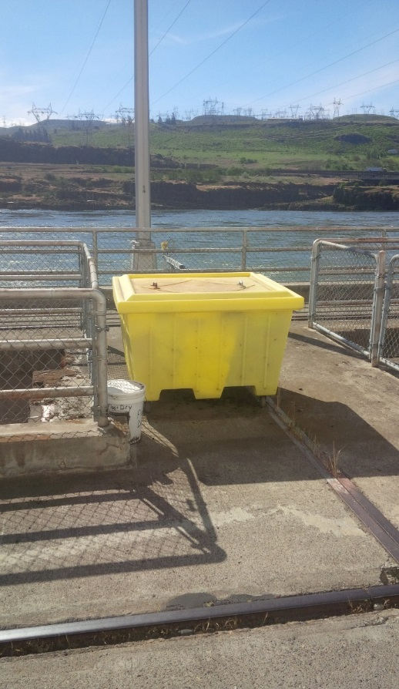
Spill Prevention, Control and Countermeasure Plan (SPCC)
Purpose: To describe measures deployed at the John Day/ Willow Creek Project to prevent oil discharges along with the response plans to an accidental oil discharge.
Content: Oil storage, accidental discharges’ risk, prevention, emergency response, equipment locations, waste disposal, volumes, transfer requirements & training.

Slide 3
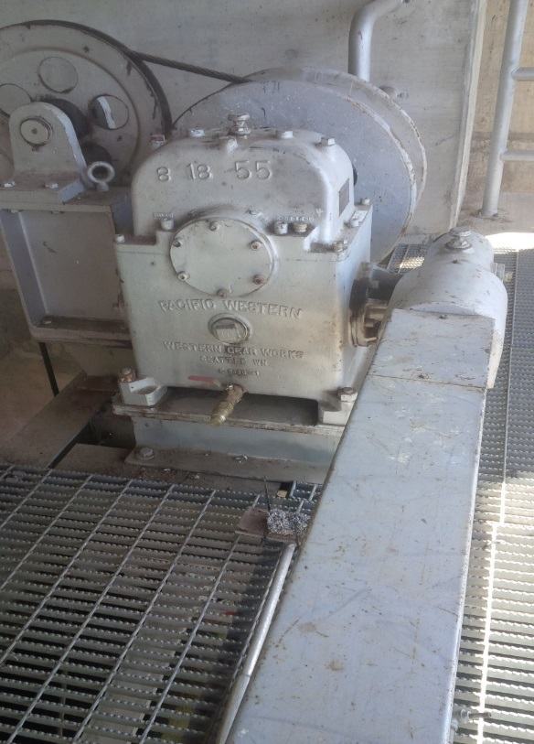
Oil Accountability Program
Includes;
Standing procedures
Oil/grease tracking and inventory
Valve locations
Oil applications
Training
Oil transfer
Equipment inspection program
JD Fisheries Team involvement on continuous basis as part of the daily inspection program.

Slide 4
Spill Response Team
Selected members of the John Day Maintenance crew will quickly and efficiently respond to an oil spill at the facility.
Planning and drills for deploying containment/ absorption booms in forebay and tailrace.
Countermeasures for both internal and external spills.
Apply WA Department of Ecology Geographic Response Plan (GRP) and work in conjunction with state and federal agencies.

Slide 5
JD Fishladders Exits’ Oil Exclusion Booms
Increased risk from the oil trains in the Columbia River Gorge.
Planning for the exclusion/deflection booms for the JD South and North Fishways’ exits. Need funding and support from JD Environmental Section (currently without staff, hiring soon..)

